Slide 1



Reservoir Water Level Monitoring

Slide 2
Learning Objectives
Understand the importance of reservoir water level monitoring for flood prevention and safety.
Learn how data preprocessing and feature engineering impact ML model performance.
Apply machine learning (Random Forest) to classify dam water levels into Safe and Critical.
Gain hands-on experience in data visualization, model training, and evaluation.
Demonstrate how predictive modeling can support decision-making in water resource management.

Slide 3
Tools and Technology used
Python (Pandas, NumPy, Matplotlib, Seaborn) – data processing & visualization
Scikit-learn – machine learning model (Random Forest Classifier)
IDE (IDLE) – development environment
Excel/CSV datasets – reservoir water level & flow data

Slide 4
Methodology
Data Collection – Historical dam inflow, outflow, and water level data.
Data Preprocessing – Cleaning missing values, removing inconsistencies.
Feature Engineering – Derived features like dynamic storage, inflow–outflow difference, level differences.
Visualization – Correlation heatmap, class distribution, confusion matrix.
Model Training – Random Forest Classifier with 80/20 train-test split.
Evaluation – Accuracy , classification report, confusion matrix analysis.

Slide 5
Problem Statement:
Dams like the Three Gorges Dam hold immense amounts of water, posing a risk of flooding or structural damage if water levels exceed safety thresholds.
Manual monitoring is time-consuming and reactive, making it difficult to prevent hazards effectively.
There is a need for an automated, data-driven approach to predict and classify water levels for proactive safety management.

Slide 6
Solution:
Implemented a Machine Learning model (Random Forest) to analyze water inflow, outflow, and reservoir levels.
Classified dam conditions into Safe vs Critical categories.
Provided a decision-support tool for reservoir management teams to predict potential risks in advance.
Achieved 80% accuracy with scope to improve

Slide 7
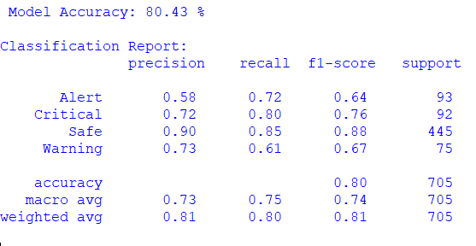
Screenshot of Output:

Slide 8
Conclusion:
Successfully demonstrated that ML can assist in dam safety monitoring using real-world hydrological data.
The model achieved reliable accuracy, showing strong potential for practical applications.
The project highlights how predictive analytics can support flood control, water resource management, and disaster mitigation.
Future scope: Improve accuracy with more features (rainfall, soil moisture, upstream dam releases) and real-time monitoring systems.

